Slide 1
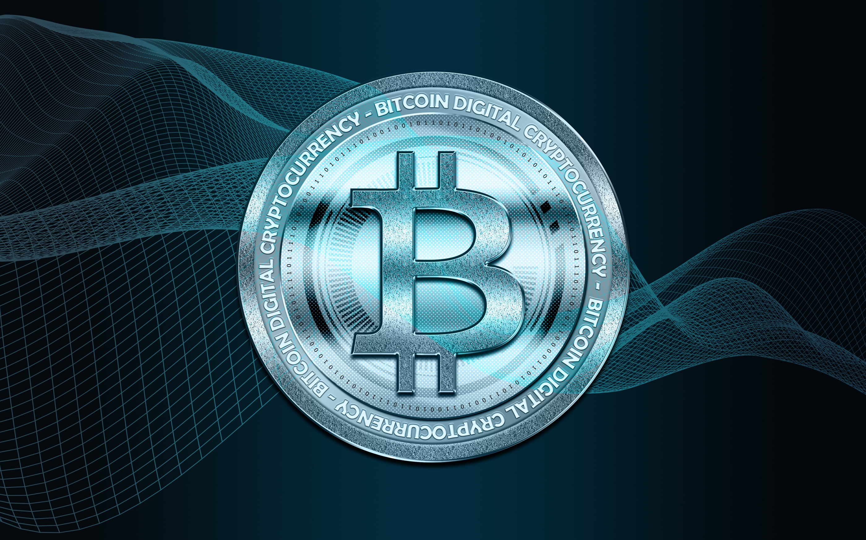
DEMYSTIFYING BLOCKCHAIN:
THE FUTURE OF SECURE DIGITAL TRANSACTIONS
Vaibhav Srivastava

Slide 2
WHAT IS BLOCKCHAIN ?
A blockchain is a distributed database or ledger that is shared among the nodes of a computer network. As a database, a blockchain stores information electronically in digital format. Blockchains are best known for their crucial role in cryptocurrency systems, such as Bitcoin, for maintaining a secure and decentralized record of transactions. The innovation with a blockchain is that it guarantees the fidelity and security of a record of data and generates trust without the need for a trusted third party.

Slide 3
FUNDAMENTALS OF BLOCKCHAIN
Public Distributed Ledgers
A blockchain is a decentralized public distributed ledger that is used to record transactions across man computers.
A distributed ledger is a database that is shared among the users of the blockchain network.
The transactions are accessed and verified by users associated with the bitcoin network, thereby making it less prone to cyberattack.
2. Encryption
Blockchain eliminates unauthorized access by using the cryptographic algorithm (SHA256) to ensure the blocks are kept secure.
Each user in the blockchain has their key.

Slide 4
FUNDAMENTALS OF BLOCKCHAIN
Proof of Work
Proof of work (PoW) is a method to validate transactions in a blockchain network by solving a complex mathematical puzzle called mining.
Note: Users trying to solve the puzzle are called miners.
2. Mining
In Blockchain, when miners use their resources (time, money, electricity, etc.) to validate a new transaction and record them on the public ledger, they are given a reward.
Note: As a reward, the miner gets 12.5 BTC (bitcoins)

Slide 5
STRUCTURE OF BLOCKCHAIN

Slide 6
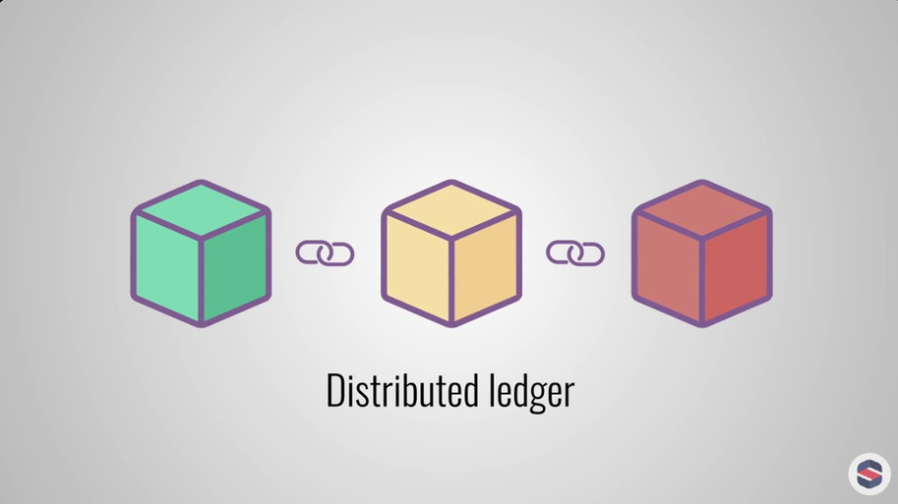
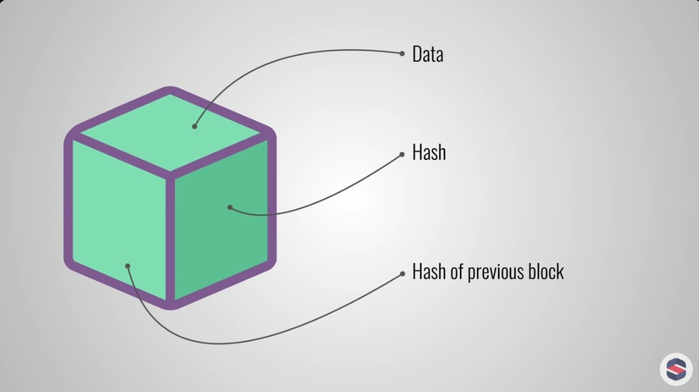
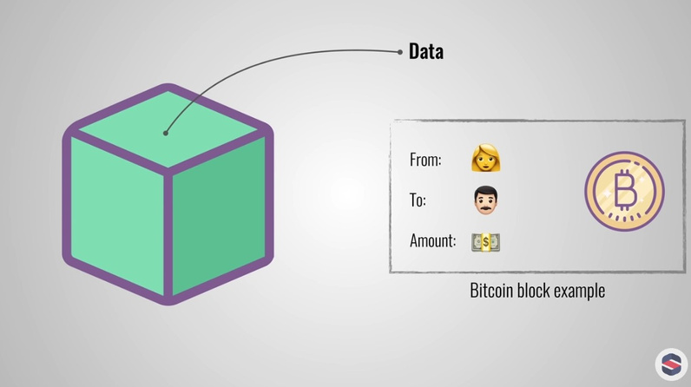
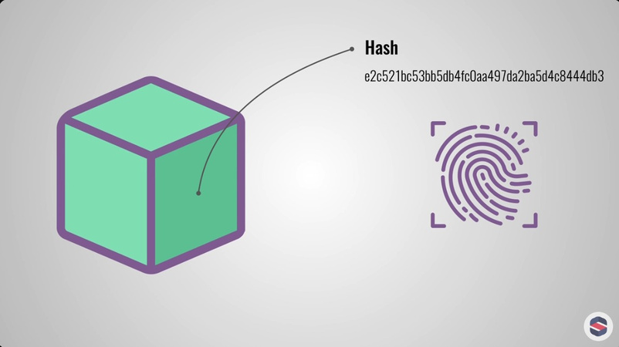
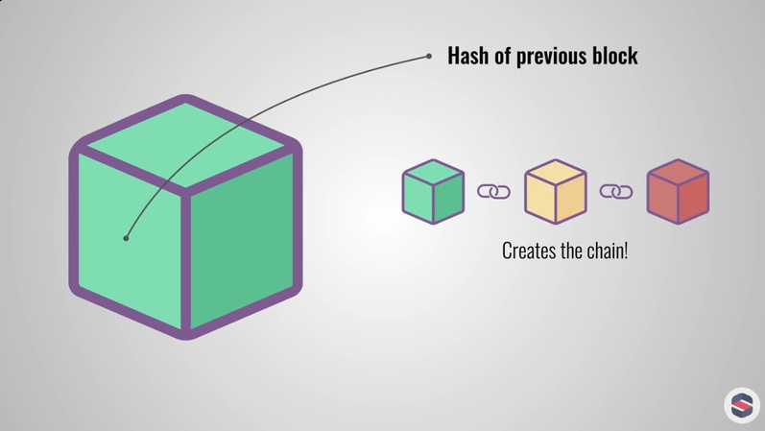
BlockChain
Block
Data
Hash
Previous Block Hash

Slide 7
FUNCTIONING OF BLOCKCHAIN

Slide 8
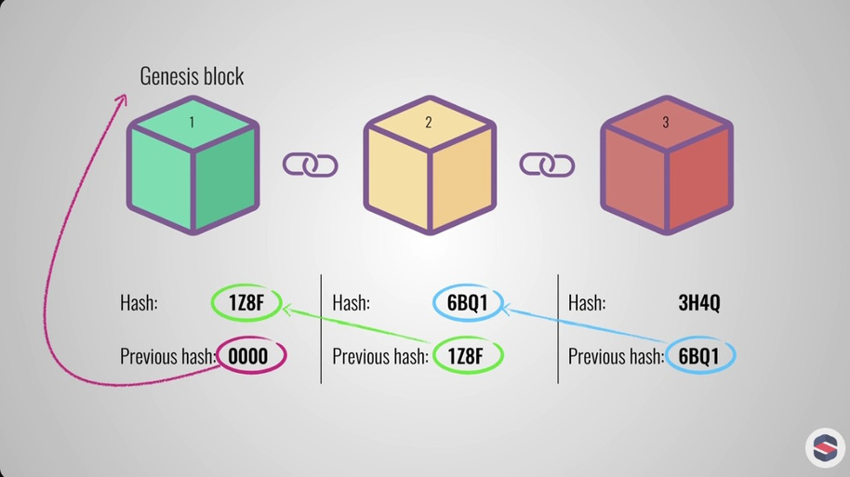
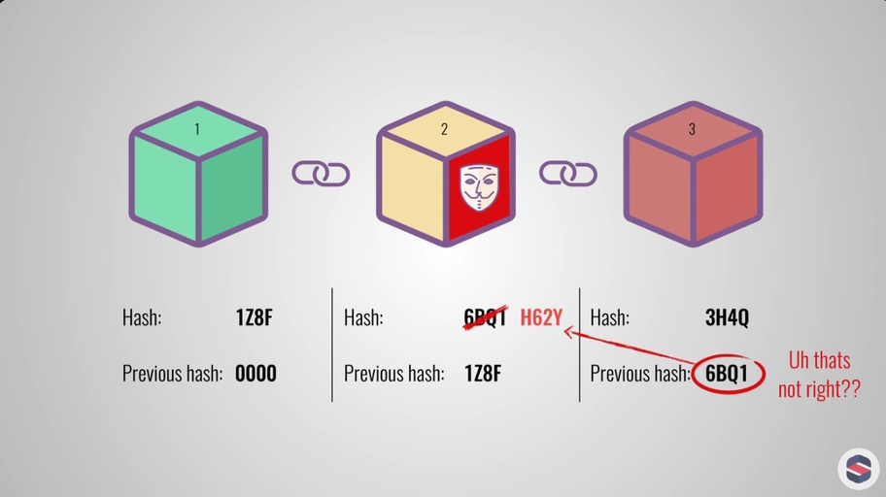
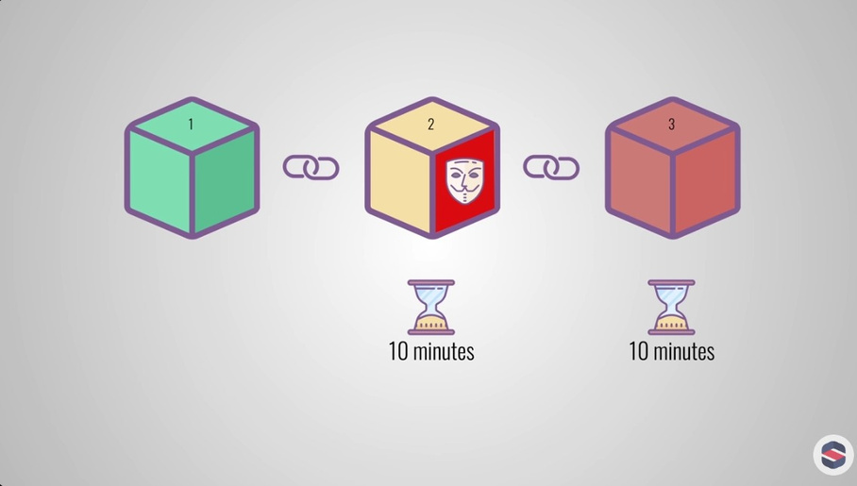
Blockchain Structure
Encryption
Proof of Work

Slide 9
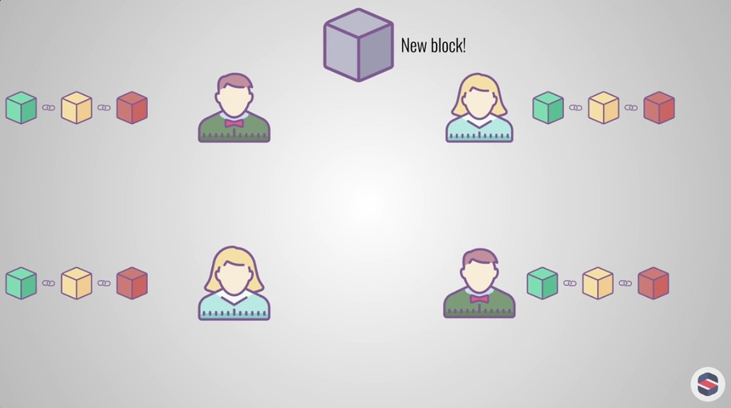
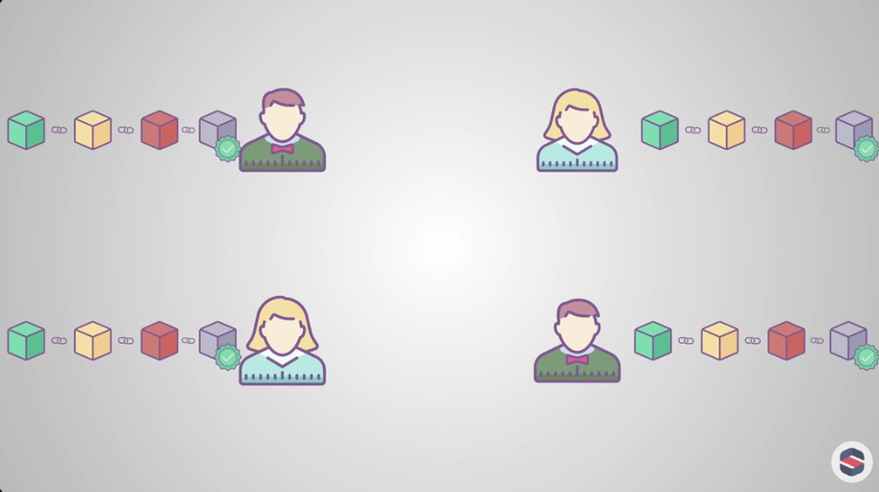
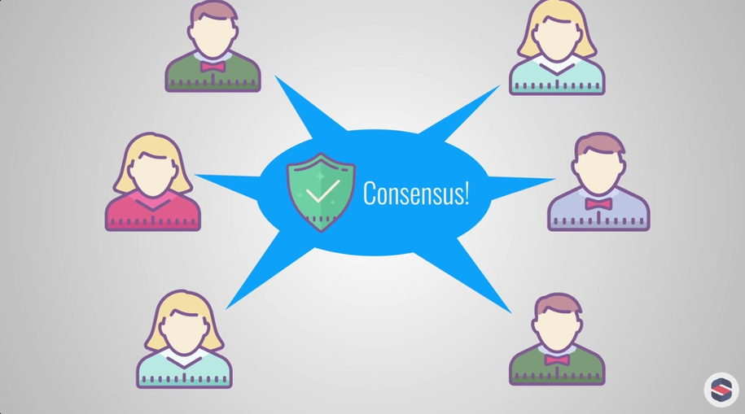
New Transaction/Block Created
Block being verified by each node
Added to Blockchain if Consensus is reached

Slide 10
ADVANTAGES OF BLOCKCHAIN
Open: One of the major advantages of blockchain technology is that it is accessible to all means anyone can become a participant in the contribution to blockchain technology.
Verifiable: Blockchain technology is used to store information in a decentralized manner so everyone can verify the correctness of the information by using zero-knowledge.
Permanent: Records or information which is stored using blockchain technology is permanent means one needs not worry about losing the data.
Tighter Security: Blockchain uses hashing techniques to store each transaction on a block that is connected to each other so it has tighter security.
Cost Reduction: As blockchain needs no third man it reduces the cost for the businesses and gives trust to the other partner.

Slide 11
DISADVANTAGES OF BLOCKCHAIN
Scalability: It is one of the biggest drawbacks of blockchain technology as it cannot be scaled due to the fixed size of the block for storing information.
Time-Consuming: To add the next block in the chain miners need to compute nonce values many times so this is a time-consuming process and needs to be speed up to be used for industrial purposes.
Legal Formalities: In some countries, the use of blockchain technology applications is banned like cryptocurrency due to some environmental issues.
Prone to Rare Vulnerabilities: 51% Attack and Peripheral System Vulnerabilities

Slide 12

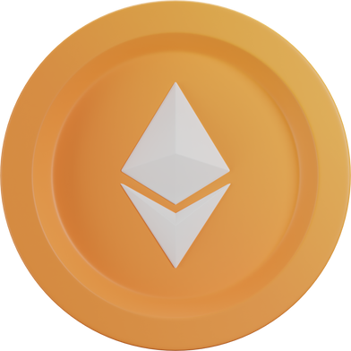
THANK YOU!

